Slide 1
Report authors:
Toby Heaps
CEO of Corporate Knights
Andrew Behar,
CEO of As You Sow
Wendy Shen-Juarez
Research Manager of
Corporate Knights
2020 Performance Update Webinar: February 13, 2020
Download the report at
www.clean200.org

Slide 2
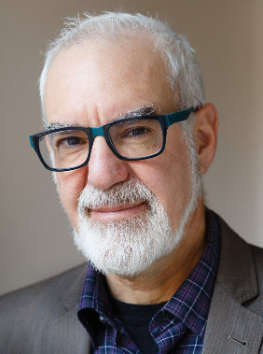
Andrew Behar
Andrew Behar,
CEO of
As You Sow

Slide 3
Audience Q & A
Download the report at
www.clean200.org

Slide 4
Featured Panelists
Toby Heaps,
CEO of
Corporate Knights
Wendy Shen-Juarez
Research Manager of
Corporate Knights
Andrew Behar,
CEO of
As You Sow

Slide 5
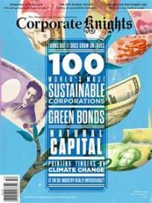
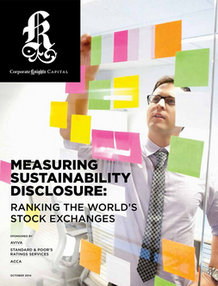
About Corporate Knights
Mission: to provide information that empowers people to harness markets for a better world
The company has a media and research division, which includes the award-winning business and society magazine Corporate Knights.
The research division produces corporate rankings, research reports and financial product ratings based on corporate sustainability performance including Cleancapitalist.com and Decarbonizer.co.
Over a decade of experience performing corporate sustainability ratings: Global 100 Most Sustainable Corporations in the World, Newsweek Green Rankings, Sustainable Stock Exchanges Ranking

Slide 6
About As You Sow
Mission: to promote environmental and social corporate responsibility through shareholder advocacy, coalition building, and innovative legal strategies
Founded on the belief that many environmental and human rights issues can be resolved by increased corporate responsibility
As You Sow communicates directly with corporate executives to collaboratively develop and implement business models that reduce risk, benefit brand reputation, and protect long-term shareholder value while simultaneously bringing about positive change for the environment and human rights.

Slide 7
What is the Clean200TM?
The Clean200: The biggest 200 public companies ranked
by green energy revenues
And why did we create it?
Global energy system is in a monumental transition
Purpose of the Clean200 list is to start a dialogue about:
How investors can co-create a clean energy economy
How to best evaluate & highlight companies already on the continuum of transition
Image Source: http://www.nationofchange.org/2015/06/12/ditching-fossil-fuelsnd-switching-to-100-renewables-no-problem-says-stanford-study/

Slide 8
Toby Heaps & Wendy Shen-Juarez
Toby Heaps,
CEO of
Corporate Knights
Wendy Shen-Juarez
Research Manager of
Corporate Knights

Slide 9
How is the Clean200 compiled?
Clean200 universe consists of companies with more than $1b in revenue and more than 10% clean energy revenues
59 company exclusions
Clean200 Negative Screens | Criteria | Number of Companies Excluded Q1 2020
Farm Animal Welfare | Identifies company laggards (Tier 5 or 6) on Farm Animal Welfare practices, based on the Benchmark for Farm Animal Welfare. | 0
Industrial Meat | Identifies meat companies, according to FactSet RBICS. | 0
Corporate Fines, Penalties or Settlements | Identifies laggard companies (bottom quartile) with high monetary fines, penalties and settlements paid as a percentage of total revenue. | 2
Tobacco | Identifies companies which earn more than 5% of revenue from tobacco using FactSet's RBICS. | 0
Controversial Weapons | The SIPRI Top 100 arms-producing and military services companies in the world ; Cluster munitions and landmines, nuclear weapons, gun manufacturers screened by As You Sow Weapon Free Funds tool | 2
Conventional Weapons | The SIPRI Top 100 arms-producing and military services companies in the world ; Cluster munitions and landmines, nuclear weapons, gun manufacturers screened by As You Sow Weapon Free Funds tool | 2
Small Arms (Hand Guns) | Identifies companies which earn more than 5% of revenue from sale of handguns using FactSet's RBICS. | 0

Slide 10
Clean200 Negative Screens | Criteria | Number of Companies Excluded Q1 2020
Blocking Climate Policy | Identifies laggards (scored less than E) in climate regulation readiness according to InfluenceMap. | 1
Severe Environmental Damage | Identifies companies which meet NBIM exclusion for "Actions or omissions that constitute an unacceptable risk of the Fund contributing to severe environmental damages". | 1
Thermal Coal | The FFI Carbon Underground Top 100 companies by coal reserves ; Morningstar coal industry company industry classification ; Companies which derive at least 30% of revenue from thermal coal as provided by Oxford Smith School, supplemented by corporate financial disclosures. | 13
Non-Green Utilities | Any utility that derives less than 50% revenue from green sources; Macroclimate Top 30 public company owners of coal-fired power plants. | 28
Tropical Deforestation | Scores 2 or less on Forest 500 scale; Palm oil, paper/pulp, rubber, timber, beef, and soy screened by the As You Sow/Friends of the Earth Deforestation Free Funds tool. | 8
For-Profit Prison | Identifies companies which own or operate private prisons according to FactSet RBICS and two aggregated private prison divestment lists, from American Friends Service Committee (Quaker) and Enlace International's National Private Prison Divestment Campaign. | 0
Repressive Regime | Identifies companies which derive at least 5% of their revenue from countries listed as "worst of the worst" by Freedom House. | 0

Slide 11
Clean200 Negative Screens | Criteria | Number of Companies Excluded Q1 2020
Global Compact Principles Violators | Companies identified by RepRisk Global Compact database with a “VIOLATOR_OPERATIONS” flag under either of human rights, labour, environment or anti-corruption themes. | 0
Gambling | Identifies companies which earn more than 5% of revenue from gambling using FactSet's RBICS. | 0
Pornography | Companies classified by "Adult Entertainment" by at least one of the cohort of large pension funds with exclusion lists that Corporate Knights monitors. | 0
Excess of conventional over clean energy financing | Based on Bloomberg BNEF data and/or corporate disclosures. Companies who sum of conventional energy financing exceeds new energy financing are removed. | 0
Child/Forced labour | Source: Know the Chain. Companies which scored in bottom half of Know the Chain rating are removed. | 2
Oil &Gas | The FFI Carbon Underground Top 100 companies by oil/gas reserves. | 0
Ratio of fossil cap-ex to renewables cap ex is greater than 2:1 | Where an oil& gas company derives a minority of revenue from renewable energy sources, those whose capital expenditure towards renewable energy business to fossil-fuel energy business is less than 25% (or not disclosed )are removed. | 0

Slide 12
What is clean revenue?
Clean revenue includes revenue from all goods and services which have clear environment and - in a limited number of well-defined cases, social - benefits. This includes revenue from clean transition, low-carbon economy and circular economy revenue segments.
Research includes bottom up research (sustainability and annual reports) and commercial sources for radar purposes
Guidance on clean revenue is provided through the Corporate Knights Clean Revenue Taxonomy
Taxonomy is reviewed and updated annually
Synthesis of several sources and best practices including:
Climate Bonds Taxonomy (Climate Bonds Initiative)
EU Sustainable Taxonomy (High-Level Expert Group in Sustainable Finance)
Sustainability Account Standards Board (SASB) reporting standards
Environmental Goods and Services Sector (Eurostat)
China Green Bond Endorsed Project Catalogue
Green Bond Principles
TCFD recommended metrics

Slide 13
Examples of clean revenue
GICS Sector | Clean Revenue Segment | Examples of Clean Revenue
Financials | Clean personal and commercial banking loans | Interest revenue from renewable energy loans or green credit operations
Industrials | Electric and energy efficient products | Sales revenue from electric locomotives, energy monitoring and management equipment, wind turbines, solar panels
Consumer Discretionary | Electric and sustainability sourced products | Sales revenue from electric and hybrid vehicles, apparel from organic and sustainably harvested raw materials
Consumer Staples | Organic and sustainability harvest products | Sales revenue from organic cosmetics and personal care products, GMO-free plant based protein
Materials | Recycled and FSC/PEFC certified products | Revenue from metal recycling, recycled paper products, and FSC/PEFC lumber
Information Technology | Energy efficient hardware | Revenue from energy monitoring hardware, efficient data centers that are 100% powered by renewable energy
Utilities | Renewable energy | Revenue from renewable energy generation, transmission and distribution
To date our data has over 500 companies who earn over 20% clean revenue with a combined market cap of over USD $6.538 trillion*
*Market Cap data extracted on Jan 6, 2020

Slide 14
Who are the Clean200?
The top 10 Clean200 companies by revenue
Company | Clean Energy Product or Service
Taiwan Semiconductor Manufacturing Co Ltd | Low-energy microchip solutions
Alphabet Inc | Fully powered by renewable energy
Siemens AG | Renewable energies, transmission, smart grids, energy storage, public transport
Toyota Motor Corp | Hybrid, electric, fuel cell vehicles
HP Inc | Energy-efficient hardware
Iberdrola SA | Renewable electricity production and distribution
Cisco Systems Inc | Energy-efficient hardware
Tesla Inc | Electric vehicles
Schneider Electric SE | Energy management
Unilever PLC | Foods from sustainably-sourced ingredients

Slide 15
Clean200 Sector Breakdown
Sector | # of companies
Industrials | 79
Information Technology | 44
Materials | 26
Consumer Discretionary | 17
Utilities | 11
Consumer Staples | 8
Health Care | 5
Communication Services | 4
Real Estate | 3
Energy | 2
Financial Services | 1
Total | 200

Slide 16
Where are Clean200 from?
COUNTRY | # OF CLEAN200 COMPANIES
United States of America | 39
Japan | 28
China | 27
France | 13
Sweden | 10
Canada | 9
Germany | 7
Netherlands | 7
Korea; Republic (S. Korea) | 7
United Kingdom | 6
Switzerland | 5
Finland | 4
Hong Kong | 4
Taiwan | 4
COUNTRY | # OF CLEAN200 COMPANIES
Ireland; Republic of | 4
Denmark | 4
India | 4
Spain | 3
Brazil | 3
Singapore | 3
Belgium | 2
Austria | 2
Australia | 2
Italy | 1
Norway | 1
Turkey | 1

Slide 17
Where are
Clean200 from?
In total, European countries place a total of 69 companies in the Clean200

Slide 18
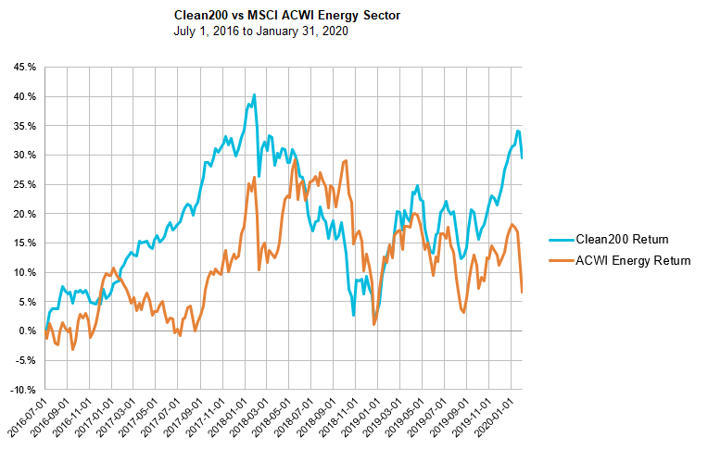
How has the Clean200 performed?
Since inception (July 1, 2016), the Clean200 has been generally ahead of the MSCI ACWI Energy Index.
Overall, the model presented in the form of the Clean200 continues to indicate that demand and market forces are driving growth for low carbon companies. Since its inception two and a half years ago, the Clean200 has generally outperformed the MSCI ACWI Energy Index.

Slide 19
Clean200 2020 vs 2019 turnover: 84 companies
New on 2020 Clean200
Name | GICS Sector | Country
BT Group PLC | Communication Services | United Kingdom
Pearson PLC | Communication Services | United Kingdom
Valeo SA | Consumer Discretionary | France
Aisin Seiki Co Ltd | Consumer Discretionary | Japan
Sumitomo Electric Industries Ltd | Consumer Discretionary | Japan
Sekisui House Ltd | Consumer Discretionary | Japan
H & M Hennes & Mauritz AB | Consumer Discretionary | Sweden
Aptiv PLC | Consumer Discretionary | United Kingdom
eBay Inc | Consumer Discretionary | United States
Essity AB (publ) | Consumer Staples | Sweden
Kimberly-Clark Corp | Consumer Staples | United States
United Natural Foods Inc | Consumer Staples | United States
Sanofi SA | Health Care | France
Biomerieux SA | Health Care | France
Takeda Pharmaceutical Co Ltd | Health Care | Japan
Danaher Corp | Health Care | United States
CIMIC Group Ltd | Industrials | Australia
Canadian Pacific Railway Ltd | Industrials | Canada
SNC-Lavalin Group Inc | Industrials | Canada
China Lesso Group Holdings Ltd | Industrials | China
Name | GICS Sector | Country
DSV A/S | Industrials | Denmark
Compagnie de Saint Gobain SA | Industrials | France
Alstom SA | Industrials | France
Nexans SA | Industrials | France
GEA Group AG | Industrials | Germany
MTR Corp Ltd | Industrials | Hong Kong
NCC Ltd | Industrials | India
Siemens Ltd | Industrials | India
Shimizu Corp | Industrials | Japan
Fanuc Corp | Industrials | Japan
West Japan Railway Co | Industrials | Japan
SMC Corp | Industrials | Japan
NSK Ltd | Industrials | Japan
THK Co Ltd | Industrials | Japan
Keikyu Corp | Industrials | Japan
NTN Corp | Industrials | Japan
Aalberts NV | Industrials | Netherlands
Keppel Corporation Ltd | Industrials | Singapore
Doosan Co Ltd | Industrials | South Korea
Skanska AB | Industrials | Sweden

Slide 20
Clean200 2020 vs 2019 turnover: 84 companies
New on 2020 Clean200
Name | GICS Sector | Country
Atlas Copco AB | Industrials | Sweden
AB SKF | Industrials | Sweden
Peab AB | Industrials | Sweden
FirstGroup PLC | Industrials | United Kingdom
Melrose Industries PLC | Industrials | United Kingdom
Waste Management Inc | Industrials | United States
Parker-Hannifin Corp | Industrials | United States
Kansas City Southern | Industrials | United States
Dover Corp | Industrials | United States
Evoqua Water Technologies Corp | Industrials | United States
Fortive Corp | Industrials | United States
China Railway Signal & Communication Corp Ltd | Information Technology | China
SAP SE | Information Technology | Germany
Accenture PLC | Information Technology | Ireland
Hitachi Ltd | Information Technology | Japan
Murata Manufacturing Co Ltd | Information Technology | Japan
Omron Corp | Information Technology | Japan
ASML Holding NV | Information Technology | Netherlands
Samsung Electro-Mechanics Co Ltd | Information Technology | South Korea
Name | GICS Sector | Country
LG Innotek Co Ltd | Information Technology | South Korea
TE Connectivity Ltd | Information Technology | Switzerland
Lite-On Technology Corp | Information Technology | Taiwan
Intel Corp | Information Technology | United States
Hewlett Packard Enterprise Co | Information Technology | United States
VMware Inc | Information Technology | United States
Analog Devices Inc | Information Technology | United States
Applied Materials Inc | Information Technology | United States
ON Semiconductor Corp | Information Technology | United States
Amcor PLC | Materials | Australia
Cascades Inc | Materials | Canada
COFCO Biochemical Anhui Co Ltd | Materials | China
Jindal SAW Ltd | Materials | India
Smurfit Kappa Group PLC | Materials | Ireland
Asahi Kasei Corp | Materials | Japan
Nitto Denko Corp | Materials | Japan
Air Water Inc | Materials | Japan
Koninklijke DSM NV | Materials | Netherlands
Clariant AG | Materials | Switzerland
Sika AG | Materials | Switzerland

Slide 21
Clean200 2020 vs 2019 turnover: 84 companies
New on 2020 Clean200
Name | GICS Sector | Country
Sims Metal Management Ltd | Materials | United States
Graphic Packaging Holding Co | Materials | United States
Weyerhaeuser Co | Real Estate | United States
Iberdrola SA | Utilities | Spain
American Water Works Company Inc | Utilities | United States

Slide 22
Carbon Clean 200 Report
DISCLAIMER
The aggregated data comprising the Clean200™ represents a snapshot of the top-ranked “clean” companies as measured by total green energy revenue based on a methodology developed by Corporate Knights and As You Sow from data in the Bloomberg New Energy Finance database. The list should not be considered current or complete, or a substitute for financial data provided by a licensed financial advisor. Estimation methodologies are subject to limitations in modelling and measurement.
The information provided in the Clean200 and in this report is provided “AS IS” without warranty of any kind. Corporate Knights and As You Sow each makes no representations and provides no warranties regarding any information or opinions provided herein, including, but not limited to, the advisability of investing in any particular company or investment fund or other vehicle. While we have obtained information believed to be objectively reliable, neither As You Sow nor Corporate Knights, or any of each of their employees, officers, directors, trustees, or agents, shall be responsible or liable, directly or indirectly, for any damage or loss caused or alleged to be caused by or in connection with use of or reliance on any information contained herein, including, but not limited to, lost profits or punitive or consequential damages. Past performance is not indicative of future returns.
As You Sow and Corporate Knights do not provide investment, financial planning, legal or tax advice. We are neither licensed nor qualified to provide any such advice. The content of our programming, publications and presentations is provided for informational and educational purposes only, and should not be considered as information sufficient upon which to base any decisions on investing, purchases, sales, trades, or any other investment transactions. We do not express an opinion on the future or expected value of any security or other interest and do not explicitly or implicitly recommend or suggest an investment strategy of any kind.
Our events, websites, and promotional materials may contain external links to other resources, and may contain comments or statements by individuals who do not represent As You Sow or Corporate Knights. As You Sow and Corporate Knights have no control over, and assume no responsibility for, the content, privacy policies, or practices of any third party websites or services that you may access as a result of our programming. As You Sow and Corporate Knights shall not be responsible or liable, directly or indirectly, for any damage or loss caused or alleged to be caused by or in connection with use of or reliance on any such content, goods or services available on or through any such websites or services.
Copyright © 2020 As You Sow and Corporate Knights. All rights reserved.

Slide 23
Andrew Behar
Andrew Behar,
CEO of
As You Sow

Slide 24
Audience Q & A
Download the report at
www.clean200.org

Slide 25
Webinar: Q & A
Toby Heaps,
CEO of
Corporate Knights
Wendy Shen-Juarez
Research Manager of
Corporate Knights
Andrew Behar,
CEO of
As You Sow

Slide 26
Media Contact
Stefanie Spear
(216) 387-1609
sspear@asyousow.org
Expert/Data Contact
research@corporateknights.com
Download the report at www.clean200.org

