Slide 1
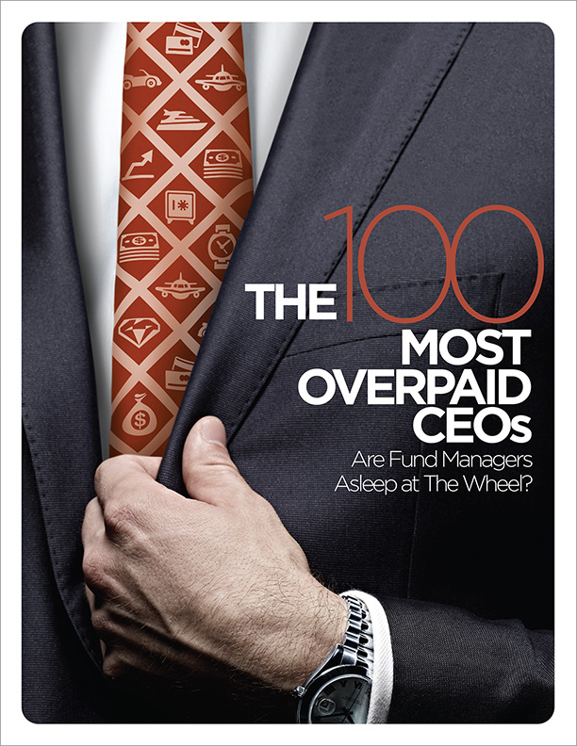
The 100 Most Overpaid CEOs
Report authors
Rosanna Landis Weaver
Melissa Walton
Download the report at:
https://www.asyousow.org/ceo-pay-reports

Slide 2
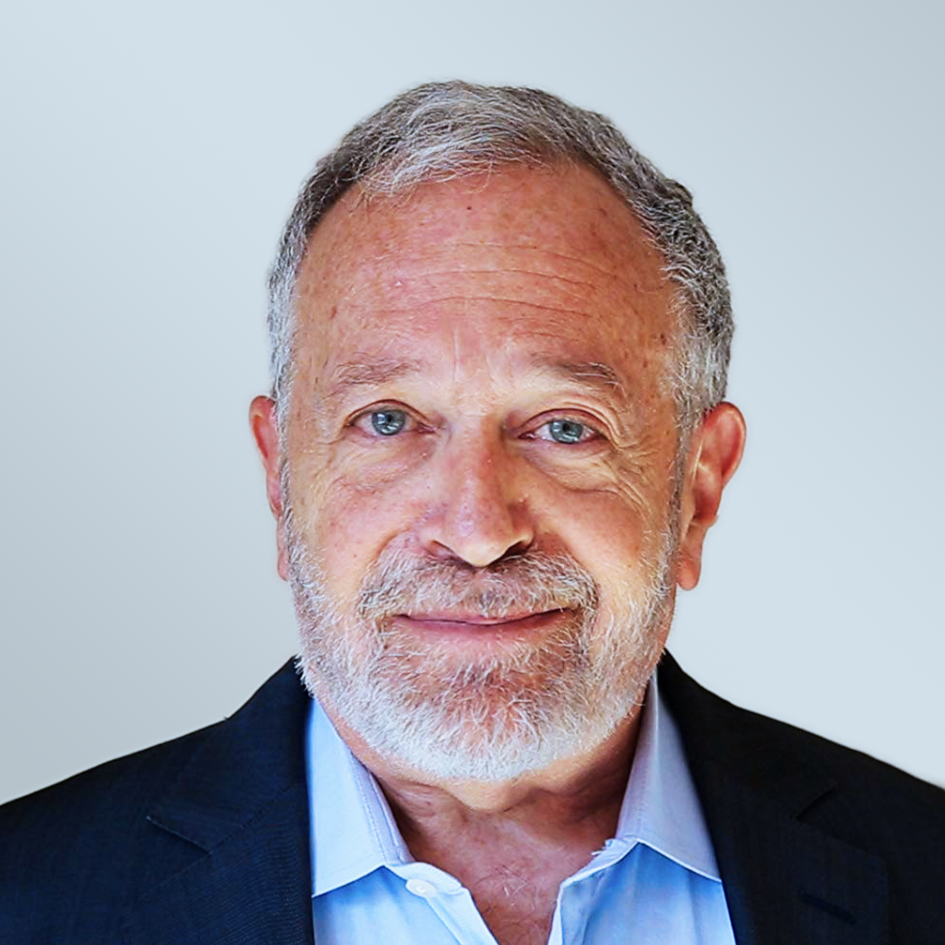
Featured Speakers
Rosanna Landis Weaver Report Author and CEO Pay Program Manager
Robert Reich Professor; Author; Former U.S. Secretary of Labor; Co-founder, Inequality Media
R. Paul Herman
CEO, HIP Investor Ratings + Portfolios,
Book Author

Slide 3
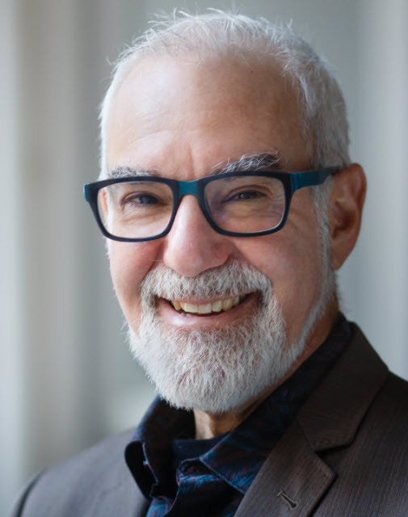
Andrew Behar
CEO
As You Sow

Slide 4
About As You Sow
Mission: to promote environmental and social corporate responsibility through shareholder advocacy, coalition building, and innovative legal strategies
Founded in 1992 on the belief that corporations must be an active part of the solutions to society’s environmental and human rights issues
30-year track record of promoting values-aligned investing and securing positive, lasting corporation change
We communicate directly with corporate executives to collaboratively develop and implement business models that reduce risk, benefit brand reputation, and protect long-term shareholder value while simultaneously bringing about positive change for the environment and human rights

Slide 5
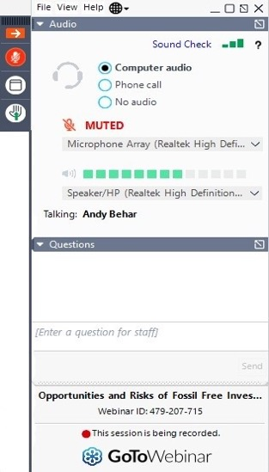
Audience Q&A
Download the report at:
https://www.asyousow.org/ceo-pay-reports
Use the Q&A window to send us your questions
Q&A Window

Slide 6
Robert Reich
Professor; Former U.S. Secretary of Labor;
Co-founder, Inequality Media; Author, The System: Who Rigged It, How We Fix It

Slide 7
Rosanna Landis Weaver
Report Author and CEO Pay Program Manager

Slide 8
Key Takeaways
2021 showed substantial increases in opposition to CEO pay packages.
Increased opposition often driven by questionable pay practices related to COVID-19.
CEO overpay is followed by stock underperformance.

Slide 9
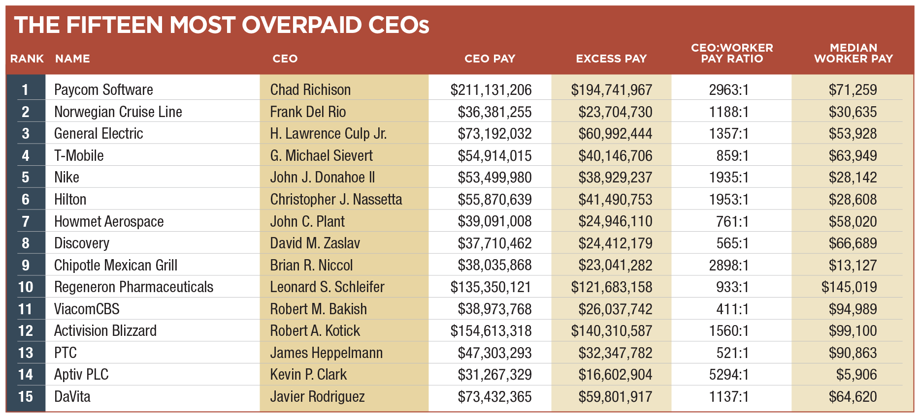

Slide 10
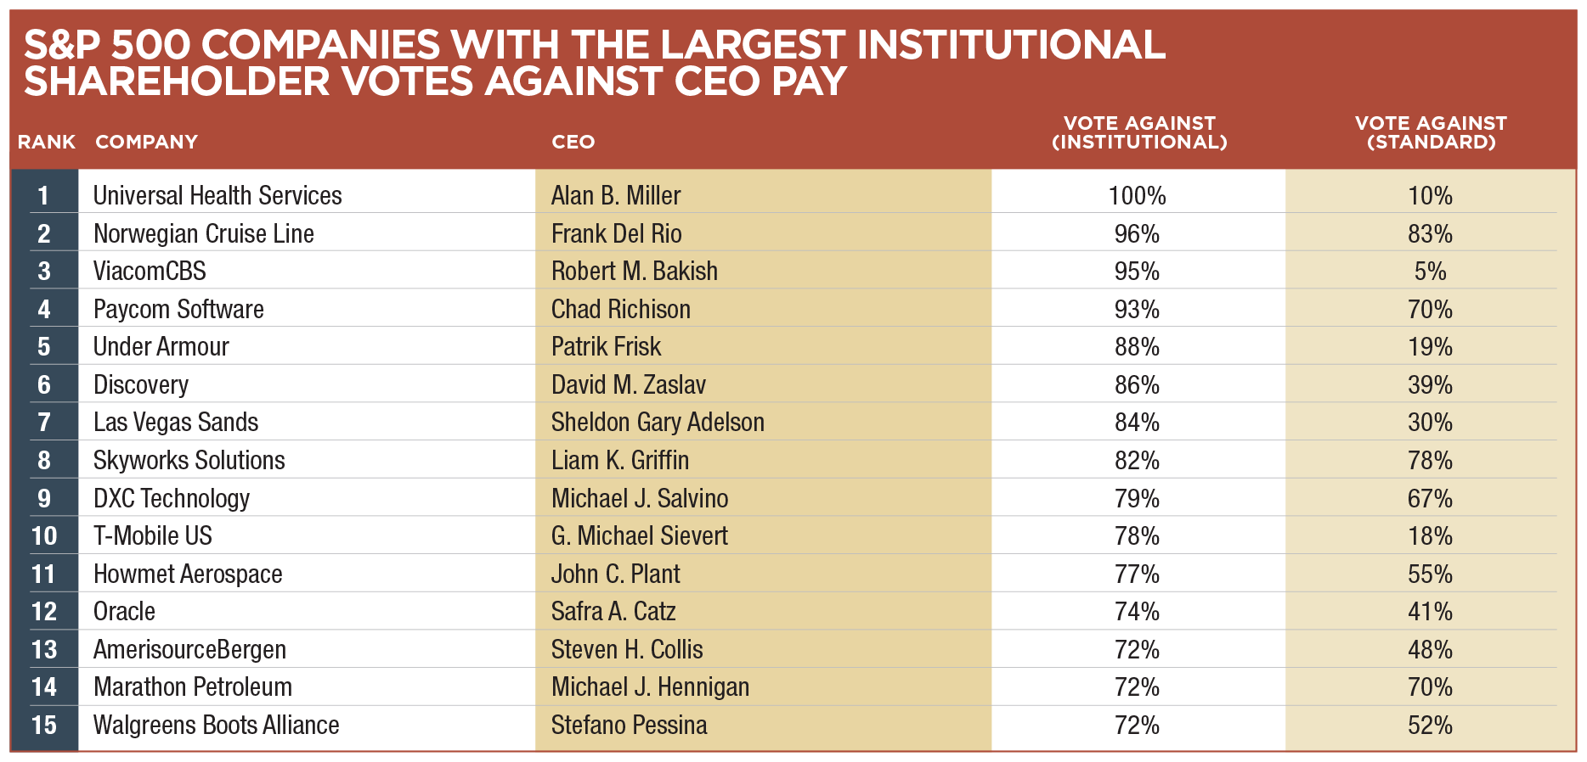

Slide 11
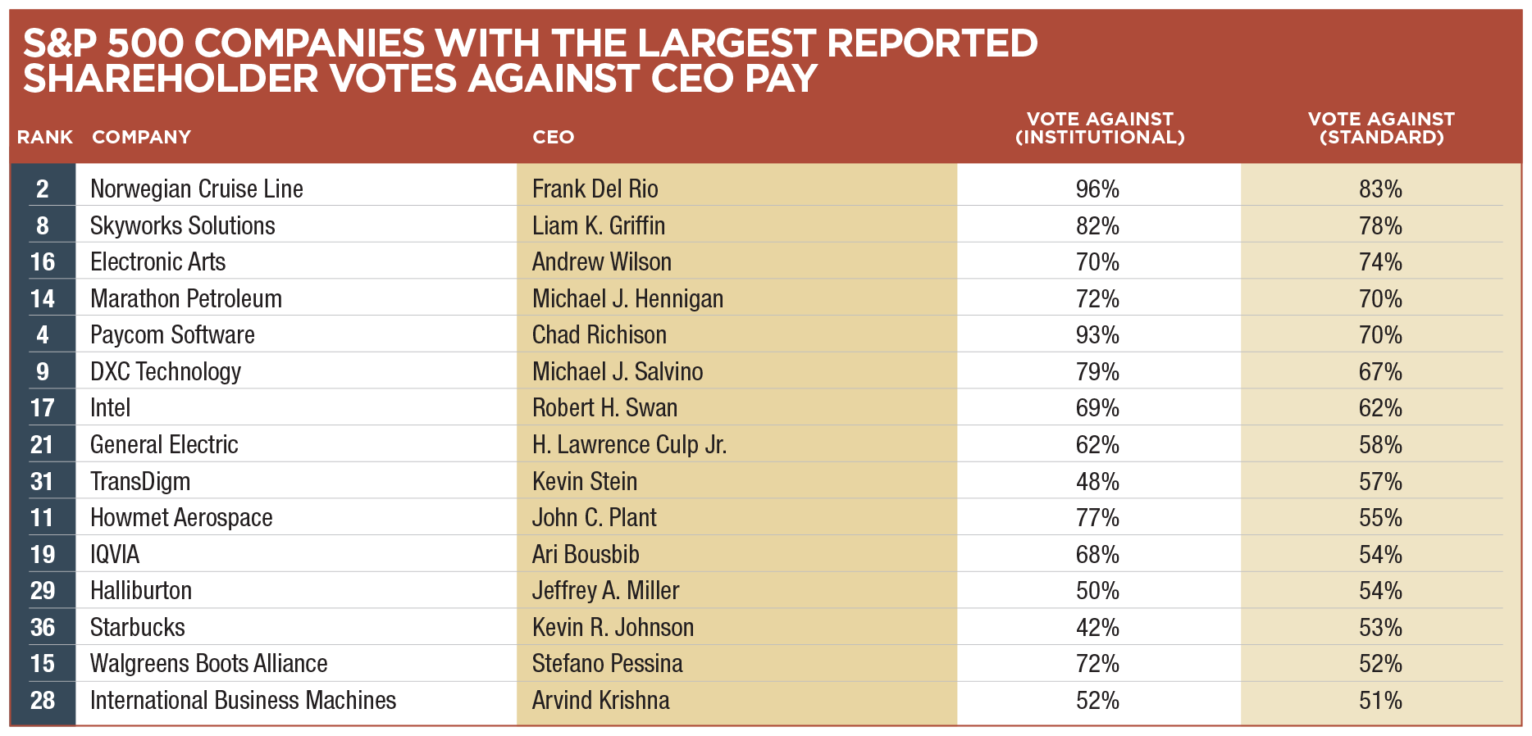

Slide 12
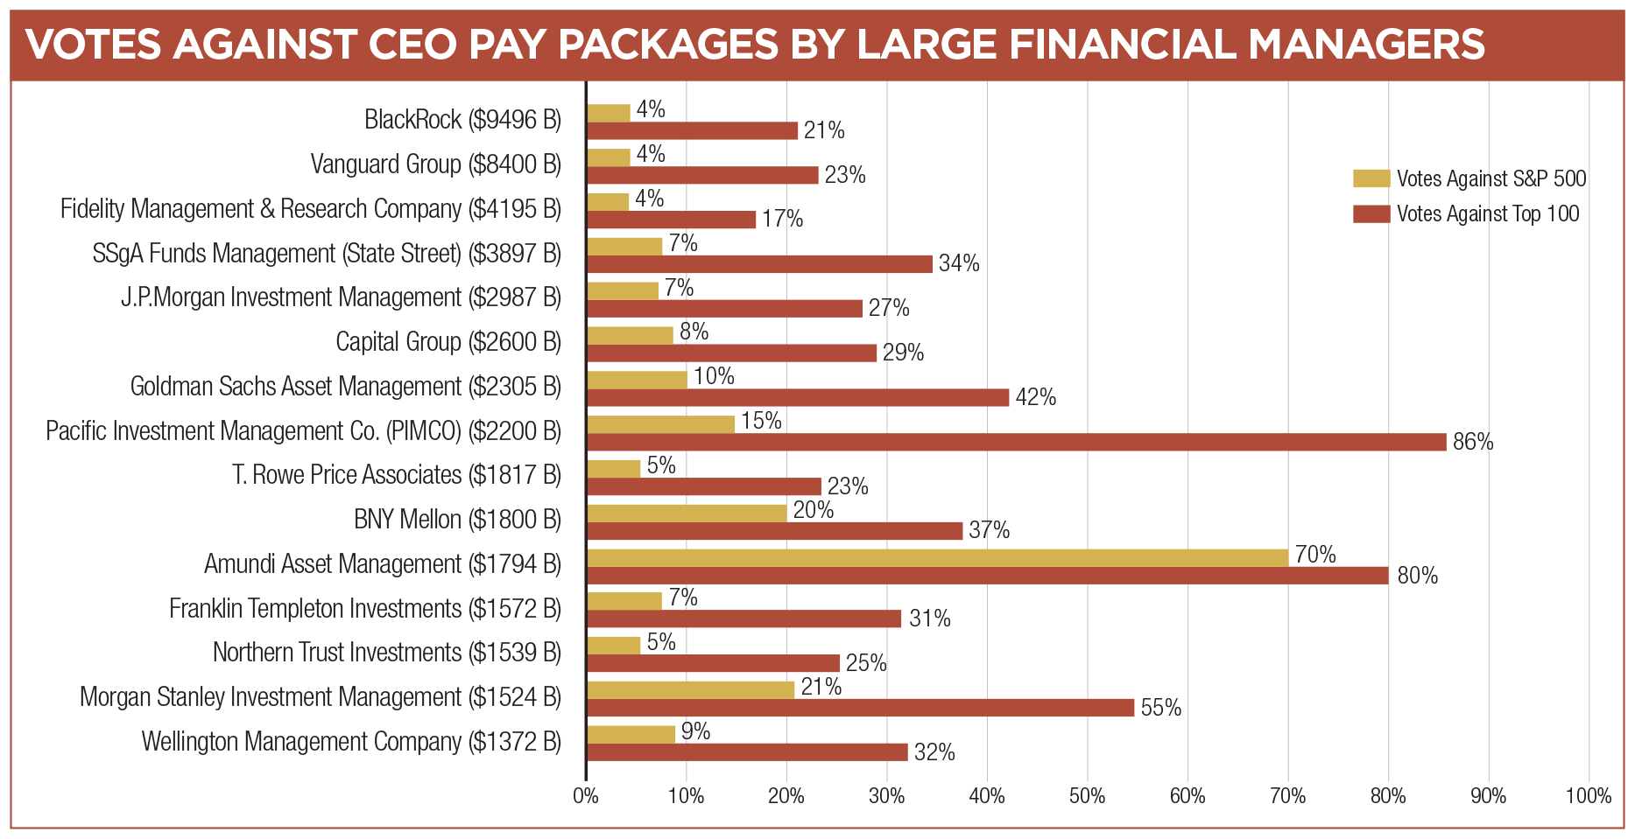

Slide 13
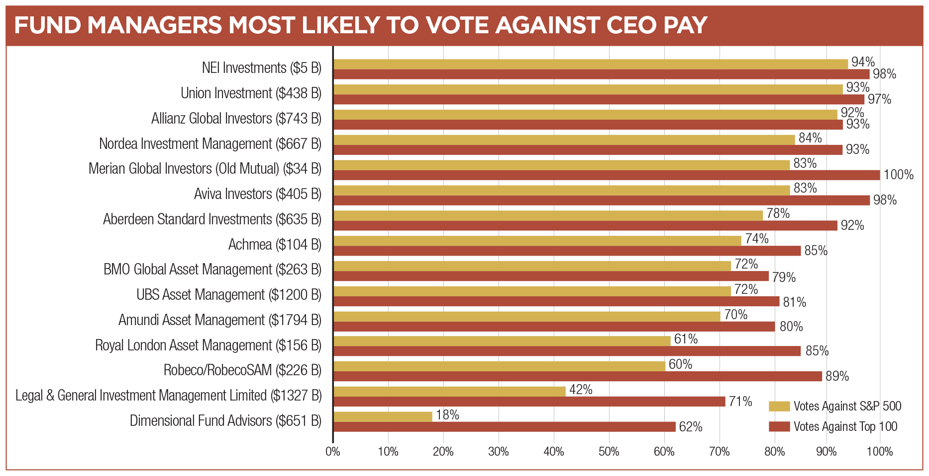

Slide 14
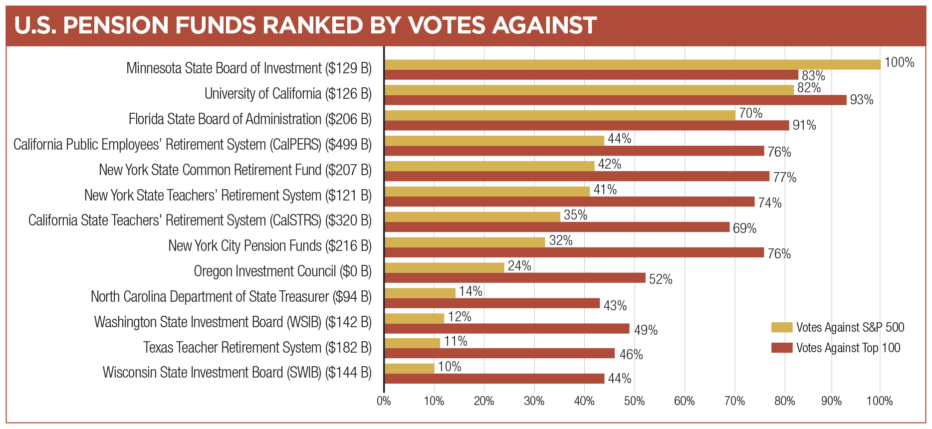

Slide 17
COVID-19 COVID-19 highlighted how too many boards and CEOs treated performance pay as an entitlement. Most shareholders said NO.
Walgreens-Boots Alliance
53% against
Used COVID-19 to justify poor performance and changed goals mid-cycle.
Norwegian Cruise Lines 83% against
Large pay awarded despite horrific performance.
Transdigm
57% against
Vesting without meeting goals.
Sealed Air
45% against
Extended timing on award.
General Electric
62% against
Used COVID-19 as an excuse to replace an award with one with lower metrics.

Slide 18
R. Paul Herman
CEO, HIP Investor
Ratings + Portfolios;
Co-editor, co-author:
Global Handbook of Impact Investing

Slide 19
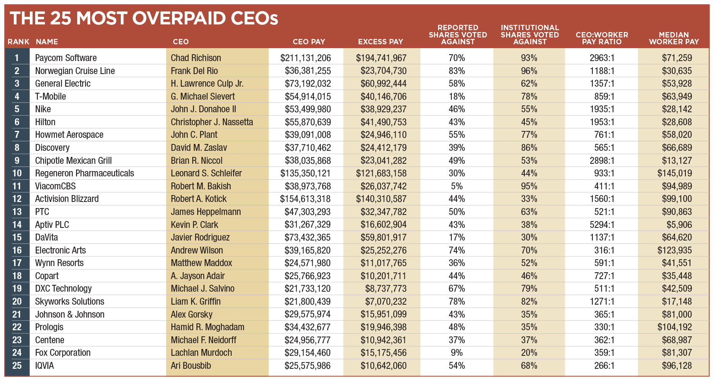
Top 25 Most Overpaid CEOs (HIP Regression Excess)
This report has a strong focus on financial manager voting, which is disclosed on an annual basis. The pay packages evaluated were those voted on in the year prior to June 30, 2021. Thus, some CEOs presented here and in Appendix A no longer hold those positions.
Source: ISS; Refinitiv; As You Sow; HIP Investor

Slide 20
100 Most Overpaid CEOs Are 20% of S&P 500 Firms, Yet Collect Increasing Share (32% --> 37%) of All CEO Pay
Overpaid CEOs Collect Nearly Double What Is Expected Based on Performance
$1.5 billion each year for 100 Overpaid CEOs averages $15 million excess annually for each CEO
Source: As You Sow; HIP Investor

Slide 21
How HIP Investor Analyzes CEO Pay and Linkages to Financial Performance
Reliable sources:
ISS for Total Disclosed Compensation for S&P500 executives
Refinitiv for financial returns, and some Executive Pay data
Relationships tested:
1, 3, 5 year performance
Total Shareholder Return (TSR), Return on Invested Capital (ROIC), and
CEO’s most-recent pay; (also tested for employee size, and “log” of employee size)
Regressions outputs:
Highest r-squared = only 0.5% for 5-year TSR of CEO-most-recent-pay
Typical correlation = all less than 7% for regressions by metric & duration
Source: HIP Investor

Slide 22
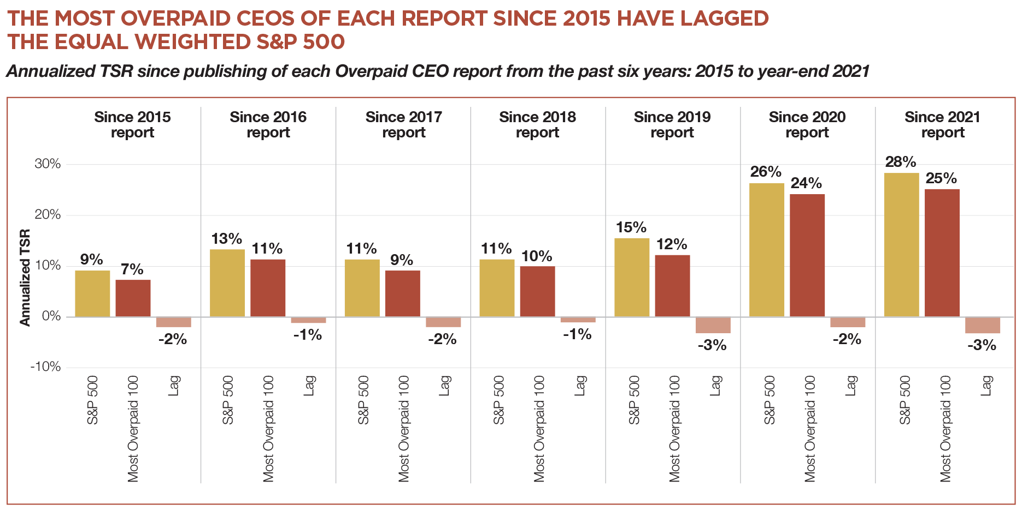
Overpaid CEOs Underperform In Each of the 7 Years of Our Annual Reports
Source: ISS; Refinitiv; As You Sow; HIP Investor

Slide 23
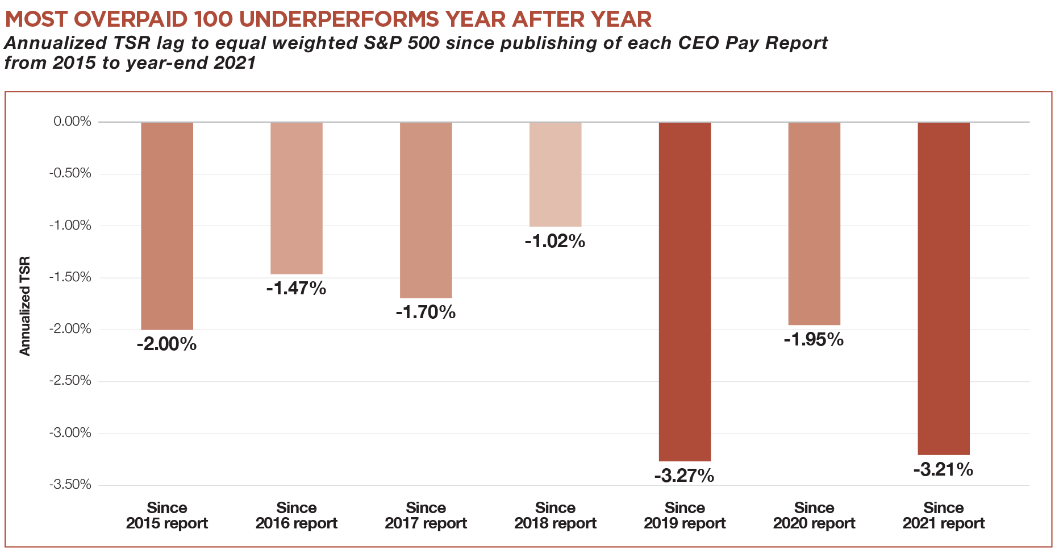
Since Our 2015 Report, Year After Year, Overpaid CEOs Underperform
Source: Yahoo Finance: As You Sow; HIP Investor

Slide 24
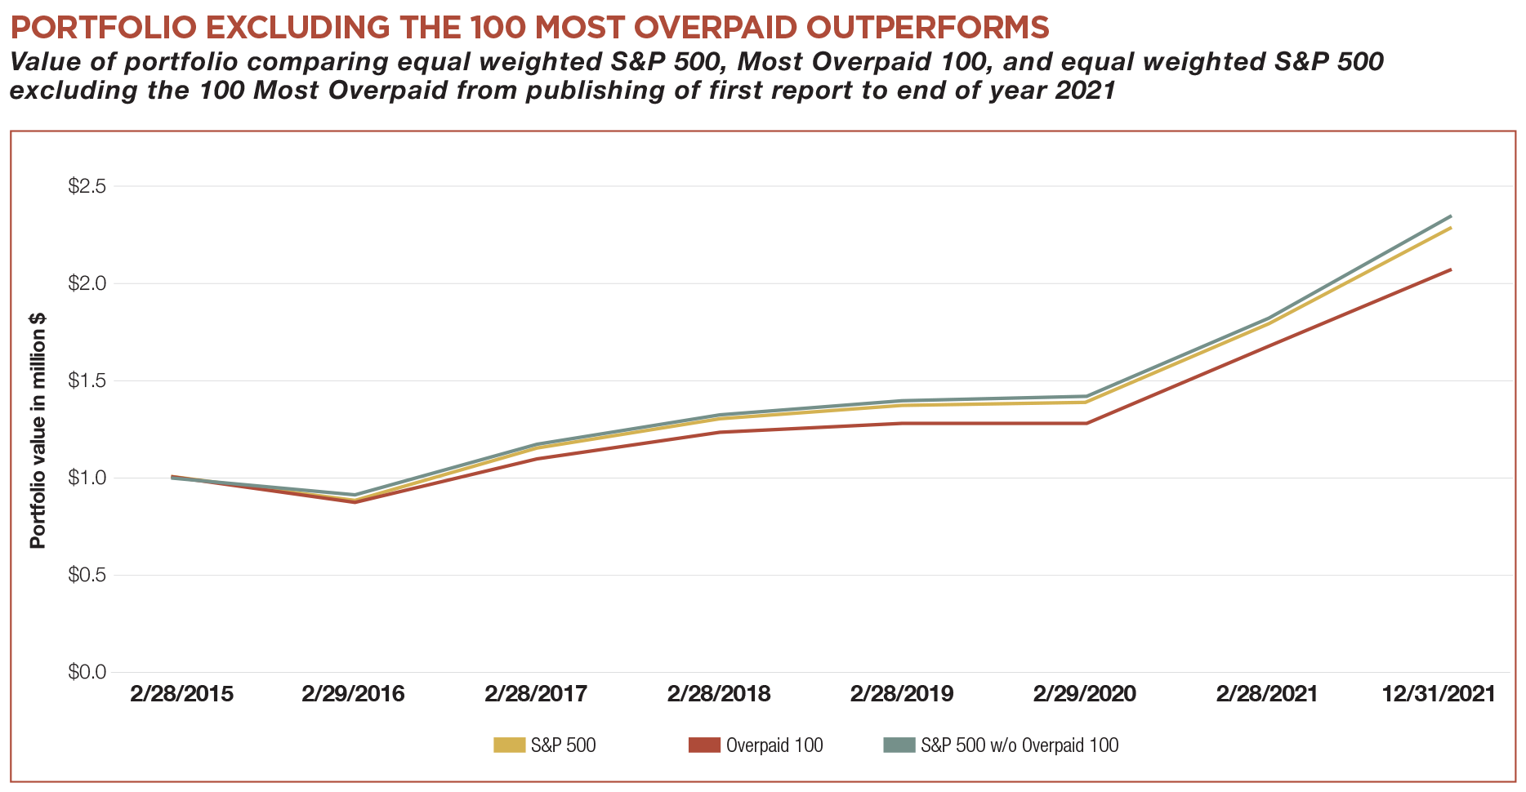
Portfolios that Exclude, Divest, or Underweight the Most Overpaid 100 Could Earn More
Divesting, underweighting, or excluding these 100 firms with Overpaid CEOs would have been better for investors
Source: ISS; Refinitiv; As You Sow; HIP Investor

Slide 25
CEO Pay Needs Better Accountability tied to Meaningful Success Metrics, including Worker Pay
Overpaid CEOs Underperform on Total Shareholder Return
Long-term compensation should be put in 5- to 10-year Escrow accounts
CEO Pay frequently linked to “old” financial metrics, like EPS
EPS = Earnings Per Share (EPS), and is an outdated metric
Yet still used by 30% of S&P500 as a CEO performance metric
Earnings are 1-year and can be massaged
Shares outstanding are frequently repurchased rather than invested in R&D or worker pay
“CEO Pay to Average Worker Pay” is a better indicator of risk
HIP Investor’s analysis of 11,000 companies globally over 10 years finds that CEOs paid 400x to 2000x the average worker frequently result in lower returns
The CEO refrain of “People are the most important asset” is not accurate for many
People are treated as short-term expenses, not long-term appreciating assets by accounting or finance on the financial statements – there are gaps in GAAP
Source: Bloomberg; HIP Investor

Slide 26
Audience Q&A
Download the report at:
https://www.asyousow.org/ceo-pay-reports
Use the Q&A window to send us your questions
Q&A Window

Slide 27
Q&A
Rosanna Landis Weaver Report Author and CEO Pay Program Manager
Robert Reich Professor; Author; Former U.S. Secretary of Labor; Co-founder, Inequality Media
R. Paul Herman
CEO, HIP Investor Ratings + Portfolios,
Book Author

Slide 28
Join Us!
Virtual After-Party
www.bit.ly/AYSworld
For Technical Support, call 510 735-8158 ex. 1
Browser: Chrome, Edge, or Firefox ONLY
Device: Macintosh, PC

Slide 29
After-Party Instructions For Technical Support, call 510-735-8158 ex. 1
www.bit.ly/AYSworld
Go To
Case Sensitive
Input your first and last name. Allow mic and video access.
Choose your avatar

Slide 30
LEGAL DISCLAIMER
The information provided on this website and all reports is provided “AS IS” without warranty of any kind. As You Sow makes no representations and provides no warranties regarding any information or opinions provided herein, including, but not limited to, the advisability of investing in any particular company or investment fund or other vehicle. While we have obtained information believed to be objectively reliable, neither As You Sow nor any of its employees, officers, directors, trustees, or agents, shall be responsible or liable, directly or indirectly, for any damage or loss caused or alleged to be caused by or in connection with use of or reliance on any information contained herein, including, but not limited to, lost profits or punitive or consequential damages. Past performance is not indicative of future returns.
As You Sow does not provide investment, financial planning, legal, or tax advice. We are neither licensed nor qualified to provide any such advice. The content of our programming, publications, and presentations is provided free of charge to the public for informational and educational purposes only, and is neither appropriate nor intended to be used for the purposes of making any decisions on investing, purchases, sales, trades, or any other investment transactions.
Our events, websites, and promotional materials may contain external links to other resources, and may contain comments or statements by individuals who do not represent As You Sow. As You Sow has no control over, and assumes no responsibility for, the content, privacy policies, or practices of any third party websites or services that you may access as a result of our programming. As You Sow shall not be responsible or liable, directly or indirectly, for any damage or loss caused or alleged to be caused by or in connection with use of or reliance on any such content, goods, or services available on or through any such websites or services.

Slide 31
Contact
Media/Press Contact
Stefanie Spear
(216) 387-1609
sspear@asyousow.org
Download the report at:
https://www.asyousow.org/ceo-pay-reports

