Slide 1
Gender-Lens Investing: Make Investing Your Values Easy
Gender-Lens Investing: Make Investing Your Values Easy
Invest Your Values Webinar
Thursday, Jan. 23, 2020

Slide 2
Gender-Lens Investing: Make Investing Your Values Easy
General Information

Slide 3
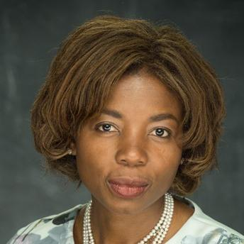
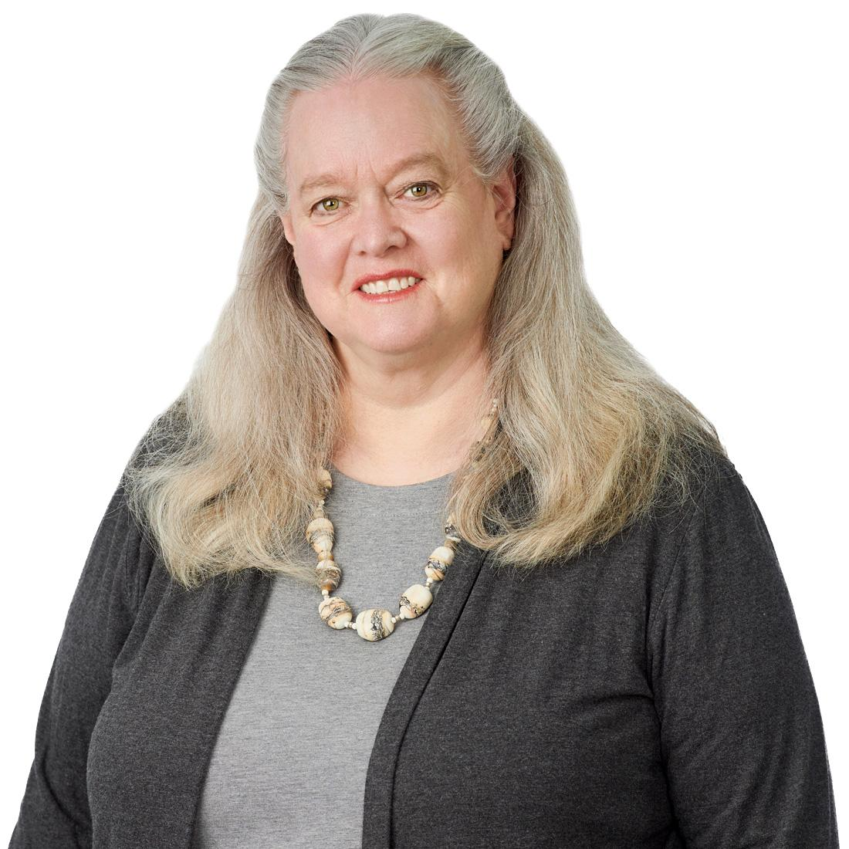
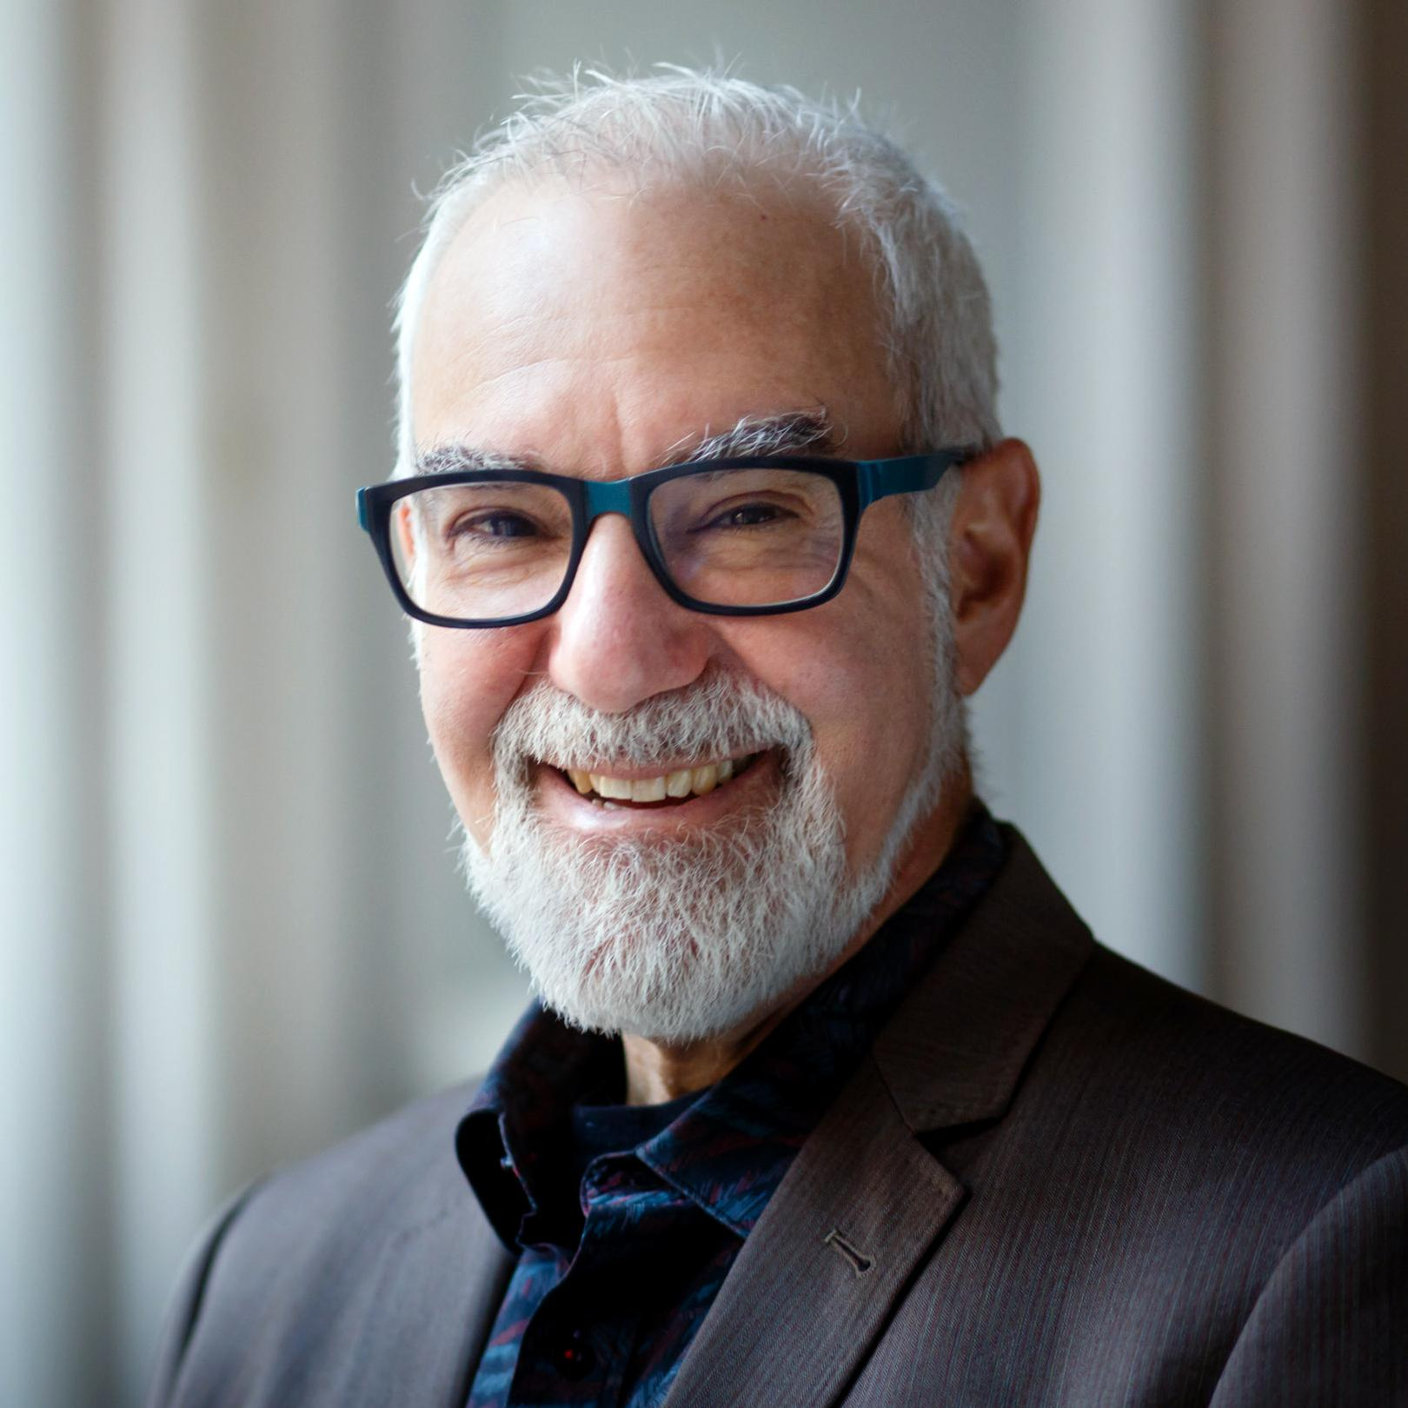
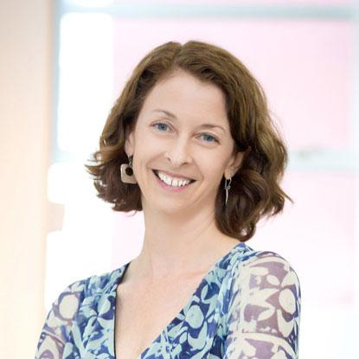
Gender-Lens Investing: Make Investing Your Values Easy
Meet the Panelists
Patience Marime-Ball Founder and CEO,
Women of the World Endowment
Julie Gorte
Senior Vice President for Sustainable Investing,
Impax Asset Management
and Pax World Funds
Andrew Behar CEO, As You Sow
Ruth Shaber M.D. Founder and President,
Tara Health Foundation

Slide 4
Gender-Lens Investing: Make Investing Your Values Easy
Patience Marime-Ball
Founder and CEO, Women of the World Endowment
Patience has a 17-year track record in structured investments and 5 years in early-stage investments. Roles include Principal Investment Officer/Global Head of Banking on Women at the International Finance Corporation (“IFC”). In 2005, she co-founded and was COO of Emerging Sun LLC. In 2010, she developed & led the IFC’s Banking on Women fixed income asset – 2018 portfolio of US$2BN+ and co-developed the first-ever Gender Bond issued on the Uridashi market. In 2013, she co-developed the $600 Women Entrepreneurs Opportunity Fund. She is Vice Chair of the International Center for Research on Women Board. She has an M.B.A. from the Kellogg School and a Juris Doctor from the Priztker Law School at Northwestern University.

Slide 5
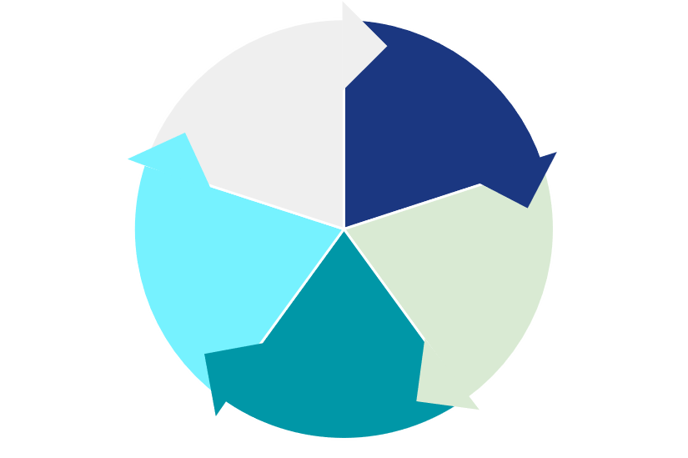
WoWE seeks to rapidly expand and accelerate the financial and intellectual capital deployed towards gender empowerment.
Gender-Lens Investing: Make Investing Your Values Easy
Build a $5B philanthropically-funded endowment, establishing an income-generating evergreen fund
Through strategic partnerships, establish Centers of Excellence at learning institutions to develop market-moving data, intelligence, and evidence
Invest endowment funds into for-profit gender lens assets across the capital spectrum
The right capital at the right time
Mainstream gender empowerment values and know-how among institutional capital holders
Deploy investment income as grant funding to nonprofit women’s organizations with proven impact in each empowerment vertical
Notes:
Public Equities
Fixed Income
Private & Venture Equity
Mezzanine
Grants
(Clarify that CoEs are facilitated, informed, and backboned by WoWE, but outside of the Endowment. 3rd parties -- mostly universities plus vertical ecosystem players -- with a mandate to produce market-actionable design, analysis, impact evidence.)

Slide 6
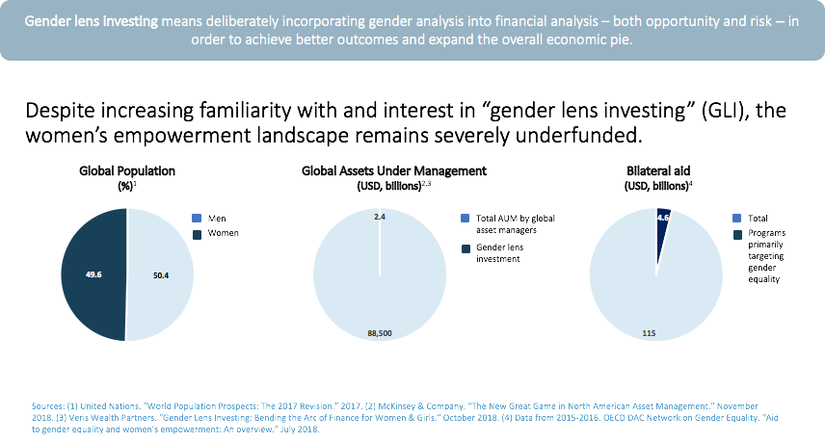
Gender-Lens Investing: Make Investing Your Values Easy

Slide 7
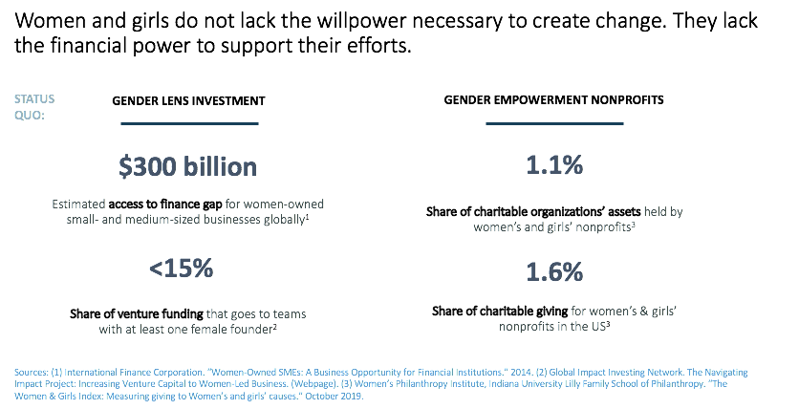
Gender-Lens Investing: Make Investing Your Values Easy

Slide 8
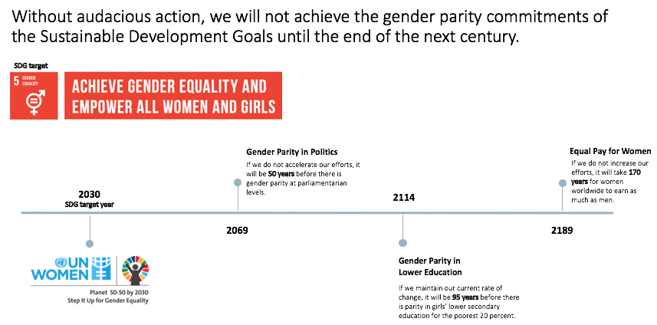
Gender-Lens Investing: Make Investing Your Values Easy

Slide 9
Gender-Lens Investing: Make Investing Your Values Easy
Julie Gorte
Senior Vice President for Sustainable Investing, Impax Asset Management and Pax World Funds
Julie Gorte is the Senior Vice President for Sustainable Investing at Impax Asset Management LLC and Pax World Funds. She oversees environmental, social and governance-related research on prospective and current investments as well as the firm’s shareholder engagement and public policy advocacy. Julie is also a member of the Impax Gender Analytics team.
Julie serves on the boards of the Endangered Species Coalition, E4theFuture, Clean Production Action, Great Bay Stewards and is the board chair of the Sustainable Investments Institute. She also serves on the Investment Committee of the United Nations Environment Programme Finance Initiative.

Slide 10
Gender-Lens Investing: Make Investing Your Values Easy

Slide 11
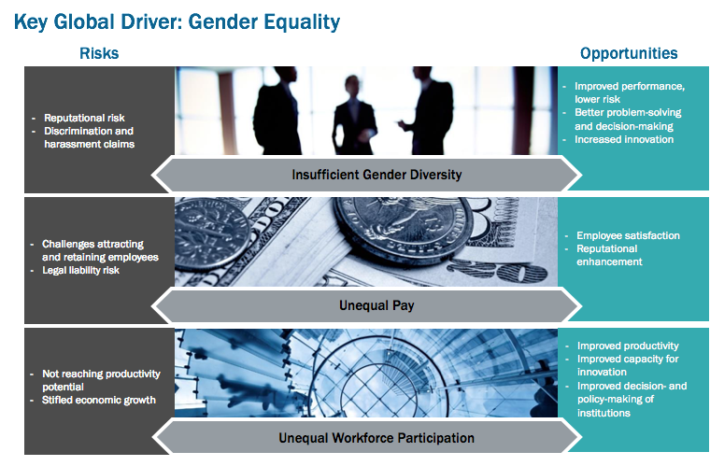
Gender-Lens Investing: Make Investing Your Values Easy

Slide 12
Gender-Lens Investing: Make Investing Your Values Easy

Slide 13
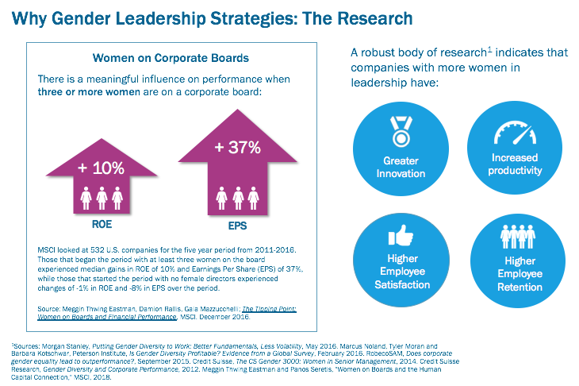
Gender-Lens Investing: Make Investing Your Values Easy

Slide 14
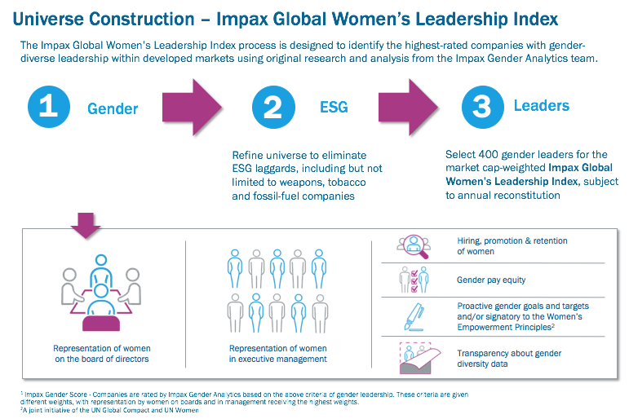
Gender-Lens Investing: Make Investing Your Values Easy

Slide 15
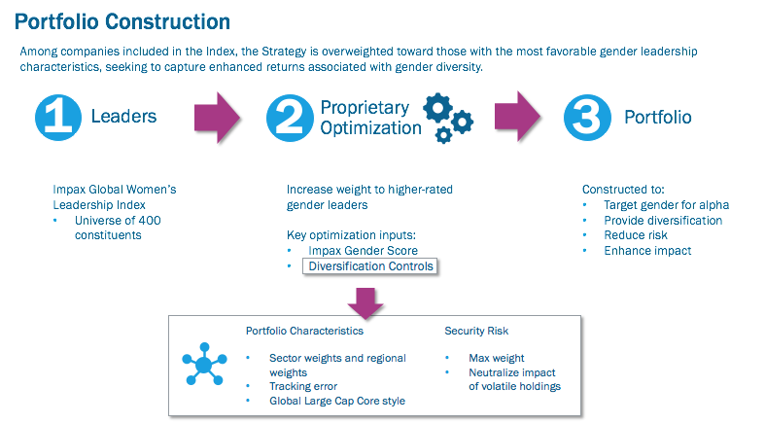
Gender-Lens Investing: Make Investing Your Values Easy

Slide 16
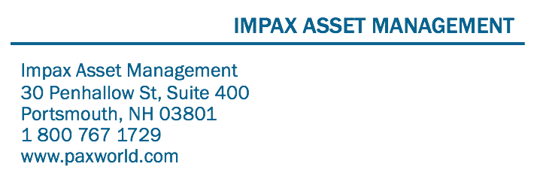
Gender-Lens Investing: Make Investing Your Values Easy

Slide 17
Gender-Lens Investing: Make Investing Your Values Easy
Andrew Behar
CEO, As You Sow
Andrew Behar, As You Sow CEO, has 30 years of experience as a Senior Executive and strategist in the cleantech, communications, and life science sectors. Prior to joining As You Sow, Andrew founded and was CEO of a start-up developing innovative fuel cell technologies. He served as COO for a social media agency focused on sustainability and has been a strategic consultant in the nonprofit sector. He is a member of the board of US Social Investing Forum (US-SIF) and is a member of the UN Sustainable Stock Exchange Green Finance Advisory Group. His book, The Shareholders Action Guide: Unleash Your Hidden Powers to Hold Corporations Accountable was published in November 2016 by Berrett-Koehler.

Slide 18
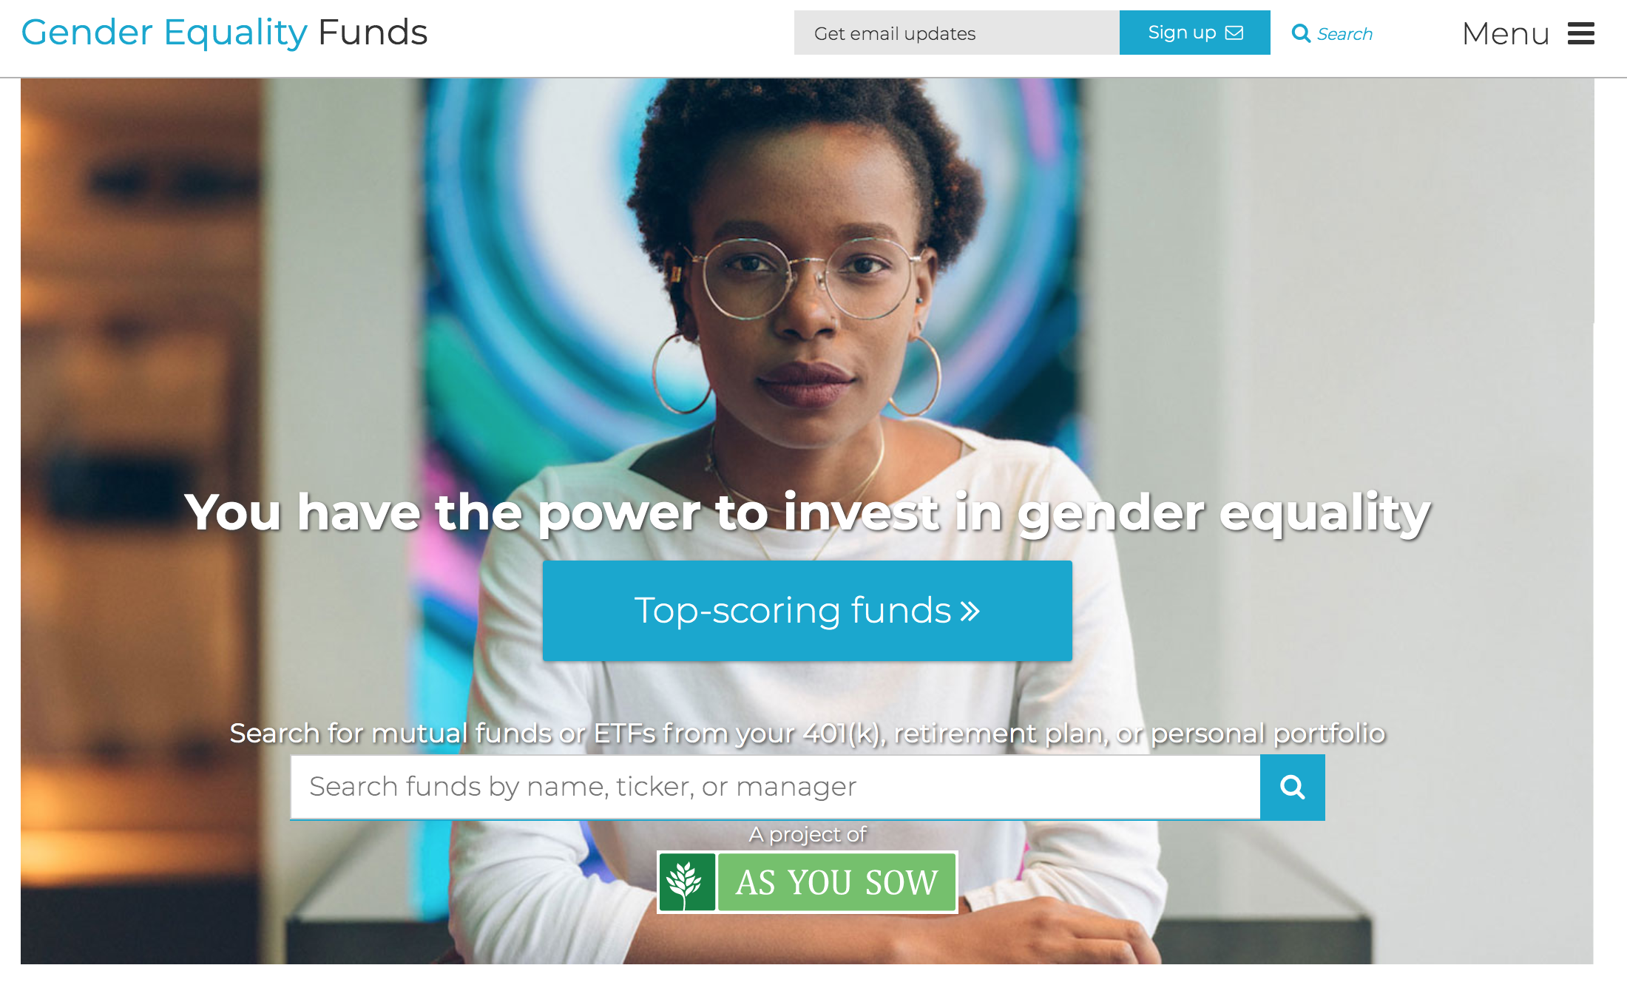
Gender-Lens Investing: Make Investing Your Values Easy

Slide 19
Gender-Lens Investing: Make Investing Your Values Easy
Ruth Shaber M.D.
Founder and President, Tara Health Foundation
Ruth Shaber MD is the founder and president of the Tara Health Foundation, which promotes health, well-being and opportunity for women and girls through innovative evidence-informed programs. She is also the co-founder and board chair of Rhia Ventures, a group of foundations and investors that collaborate to bring new types of capital and enterprise to the field of reproductive health in the United States.
Ruth started her career as an Obstetrician and Gynecology at the Kaiser Permanente South San Francisco Medical Center in 1990. In addition to her clinical responsibilities, she had many leadership positions at Kaiser Permanente including chief of Obstetrics and Gynecology, Director of Women’s Health and founder of the Women’s Health Research Institute. Ruth was the Medical Director at the Kaiser Permanente Care Management Institute from 2007 to 2012 where she worked with Kaiser Permanente's regional and national leaders to apply the best evidence and successful systems approaches to create reliable clinical performance.

Slide 20
Gender-Lens Investing: Make Investing Your Values Easy

Slide 21
Gender-Lens Investing: Make Investing Your Values Easy

Slide 22
Gender-Lens Investing: Make Investing Your Values Easy

Slide 23
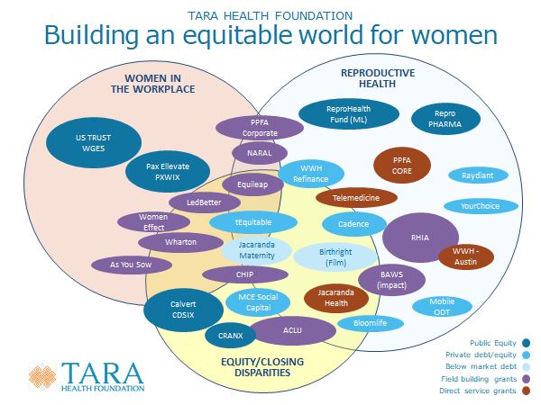
Gender-Lens Investing: Make Investing Your Values Easy

Slide 24
Gender-Lens Investing: Make Investing Your Values Easy

Slide 25
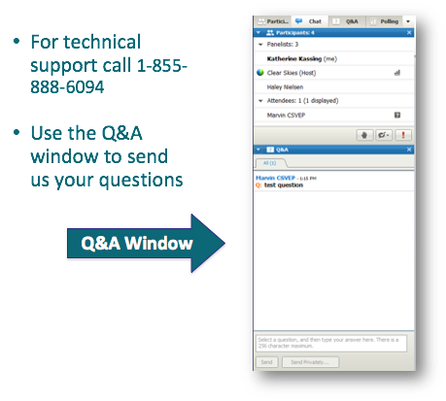
Gender-Lens Investing: Make Investing Your Values Easy
Questions and Answers

Slide 26
Gender-Lens Investing: Make Investing Your Values Easy
Questions for the Panelists
Patience Marime-Ball Founder and CEO,
Women of the World Endowment
Julie Gorte
Senior Vice President for Sustainable Investing,
Impax Asset Management
and Pax World Funds
Andrew Behar CEO, As You Sow
Ruth Shaber M.D. Founder and President,
Tara Health Foundation

Slide 27
Gender-Lens Investing: Make Investing Your Values Easy
Thank you for
joining us today!
As You Sow
Stefanie Spear
sspear@asyousow.org
GenderEqualityFunds.org
Women of the World Endowment
Patience Marime-Ball
patience@wowendowment.org
wowendowment.org

